Slide 1

Web Development 1 Module Overview

Slide 2
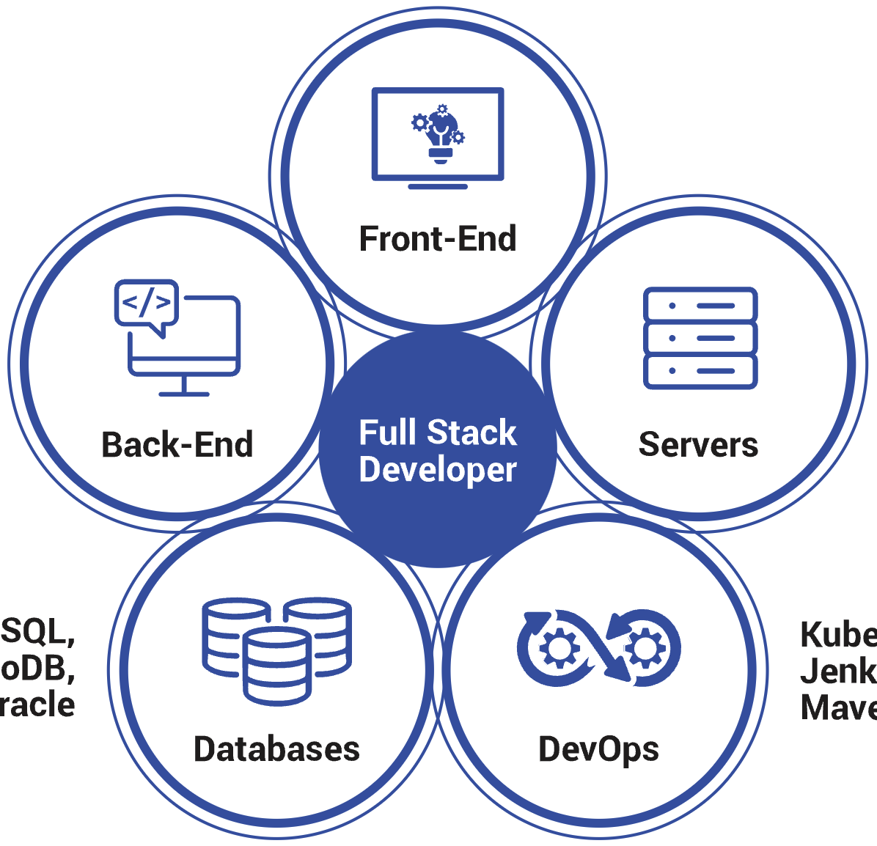

Slide 3
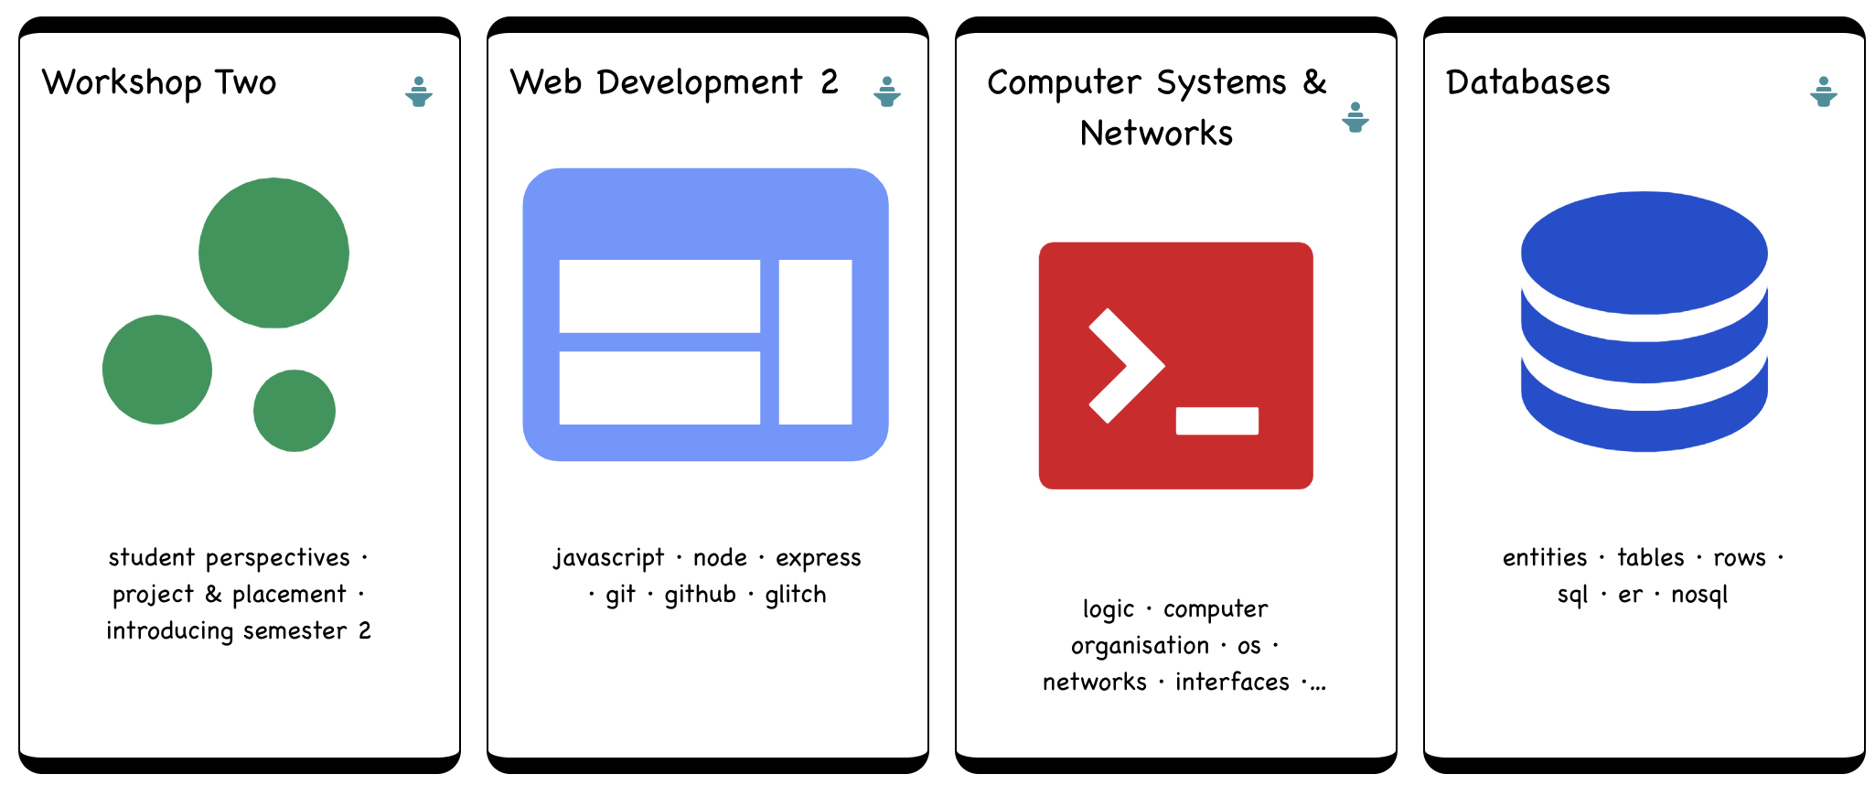
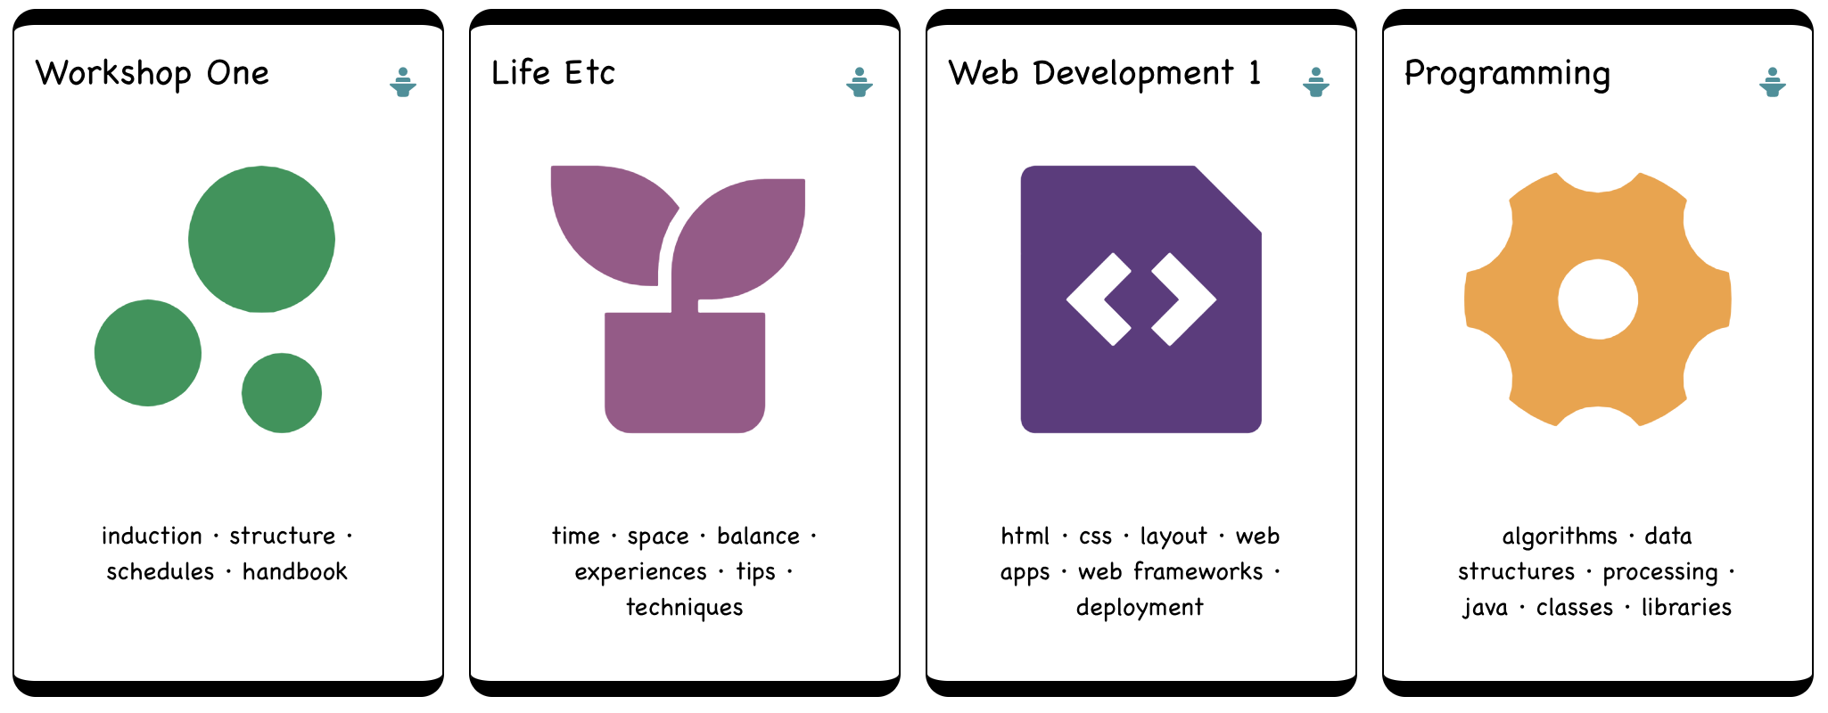

Slide 4
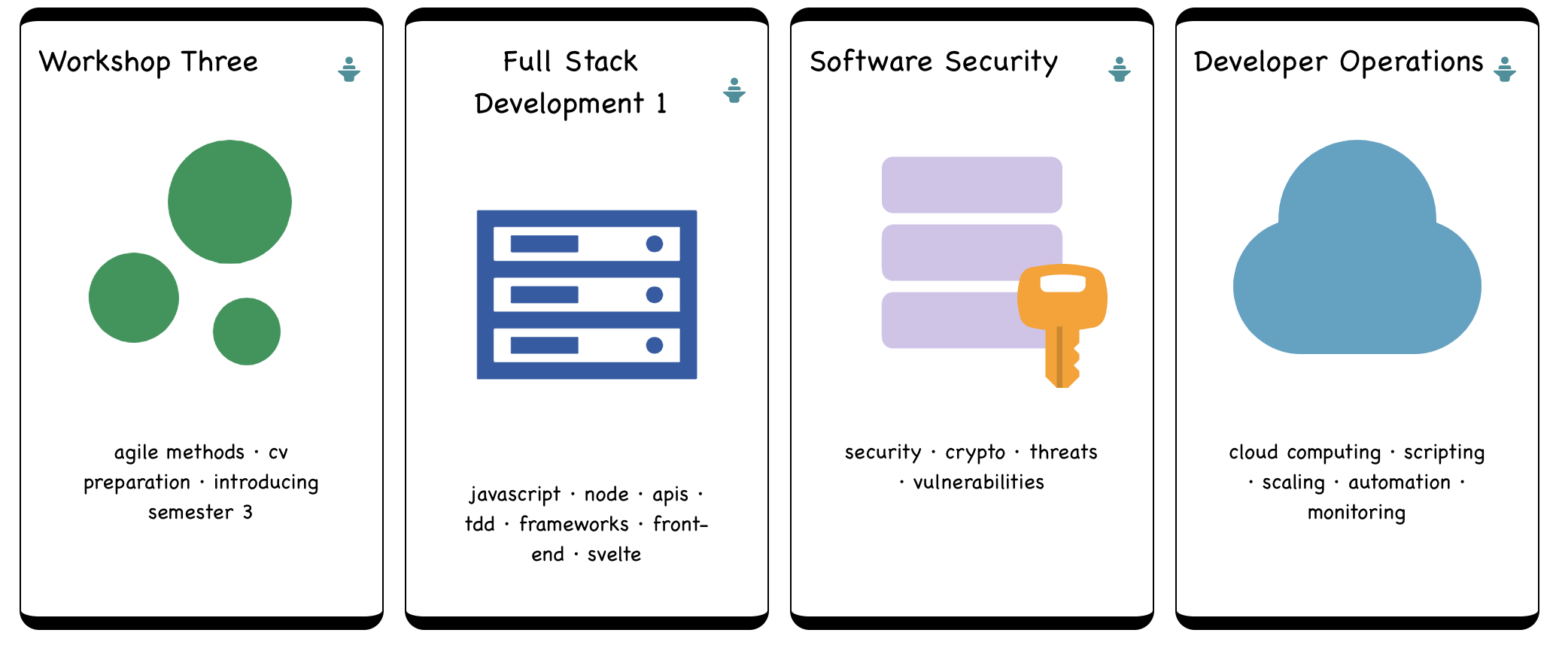
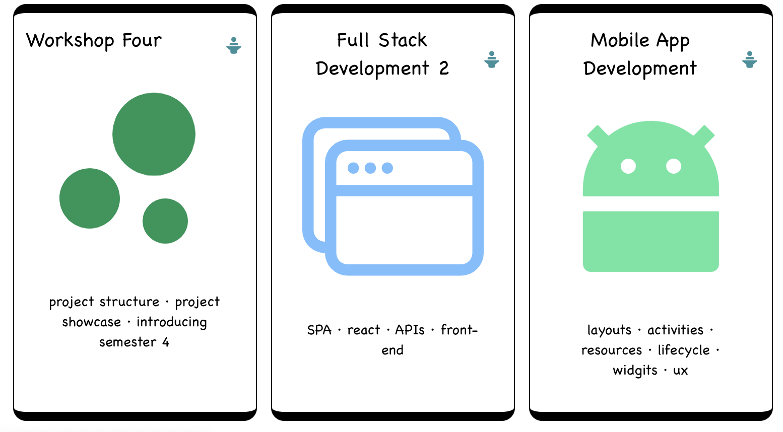
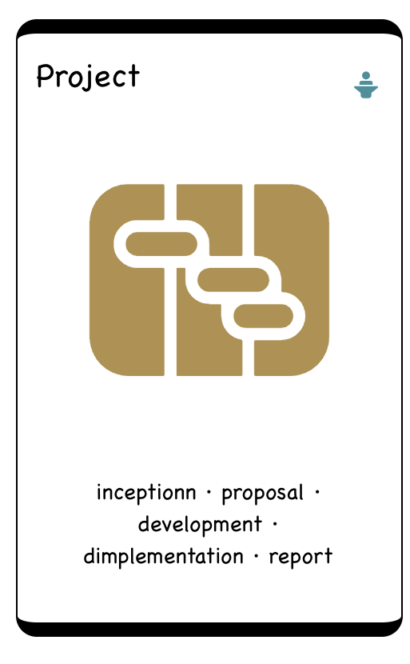

Slide 5
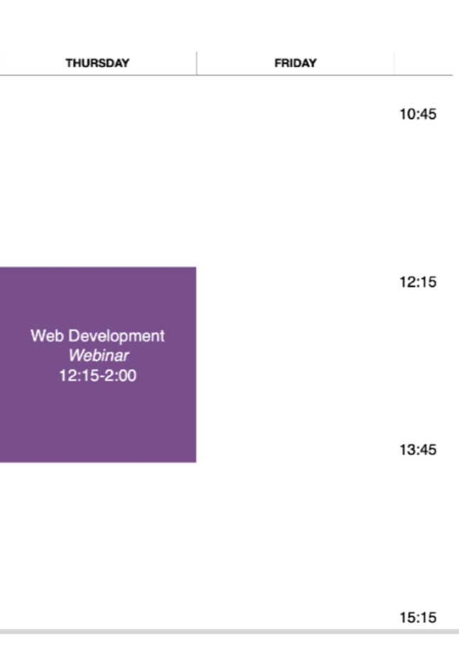
Webinar
Lab support throughout the week

Slide 6
Resources
https://tutors.dev/course/wit-hdip-comp-sci-2024-web-dev-1
https://moodle.wit.ie/course/view.php?id=202930&section=2
Please ensure you can access all of the resources

Slide 7
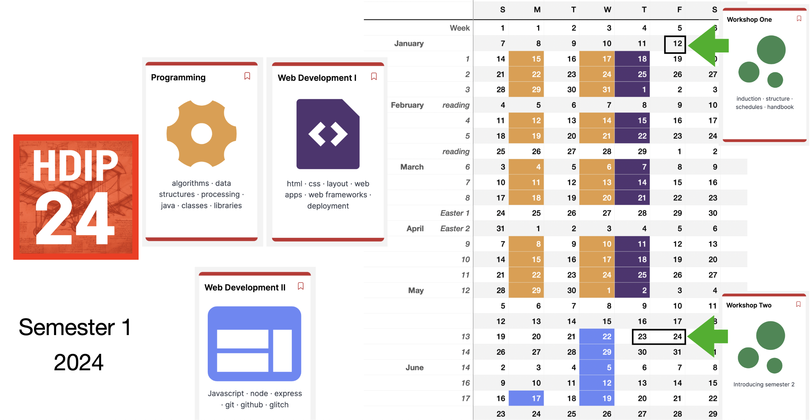

Slide 8
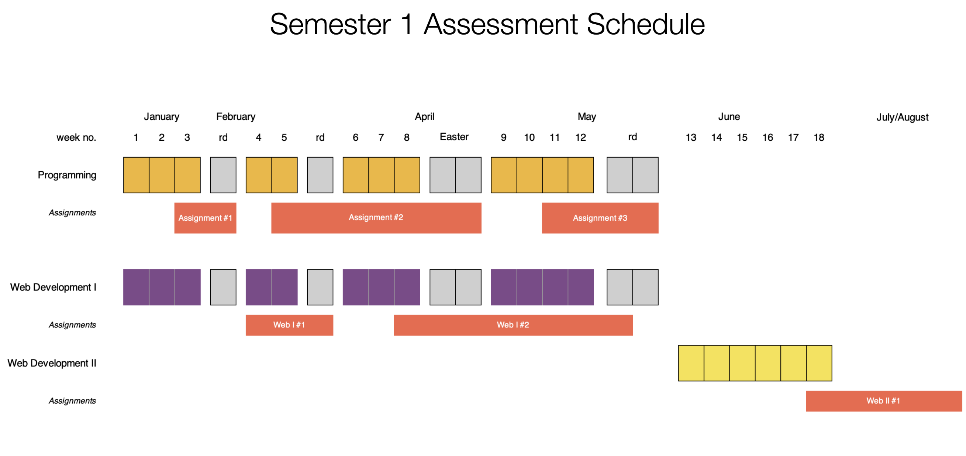

Slide 9
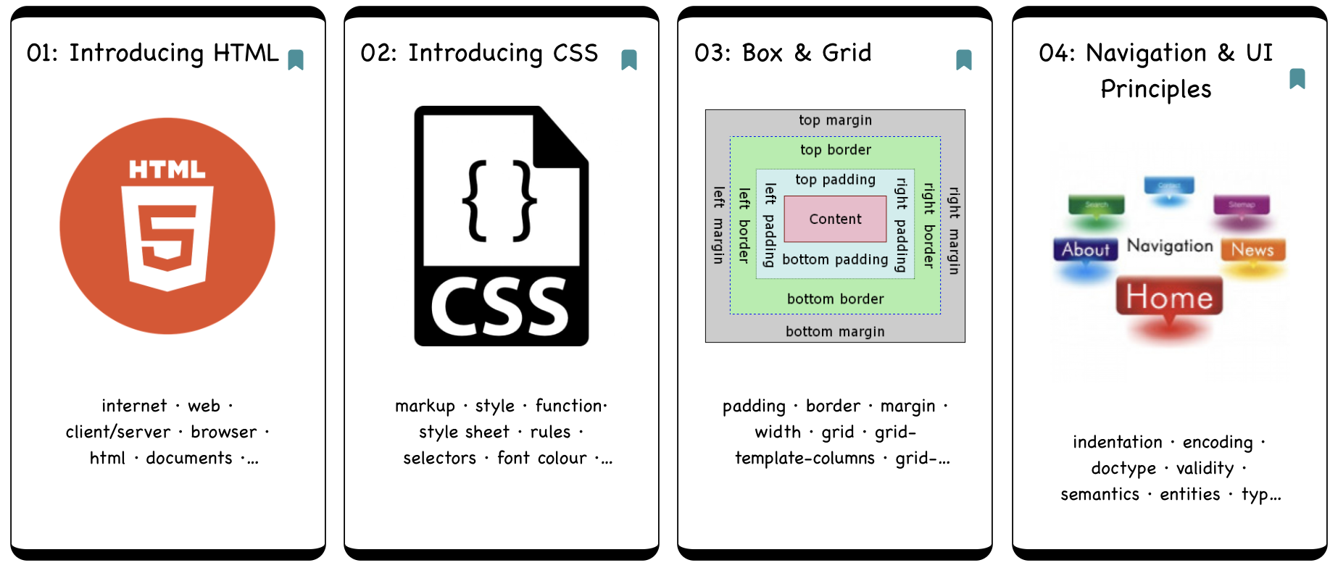
12 Topics – one topic per week
Each Topic builds on concepts, tools and techniques from previous weeks.

Slide 10
Core HTML + CSS

Slide 11
Laying out pages with CSS
Structuring a Navigation Metaphor

Slide 12
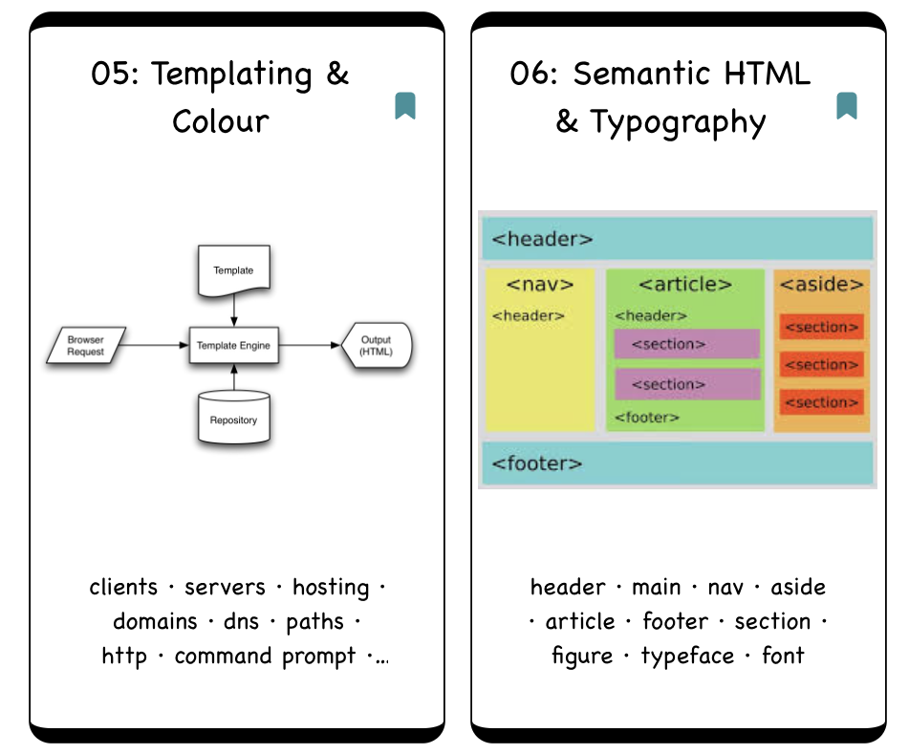
Modularising a web site
Exploring UX - Colour & Typography

Slide 13



New this year, a focus on templating, JavaScript, modern deployment/hosting services
* To be confirmed

Slide 14
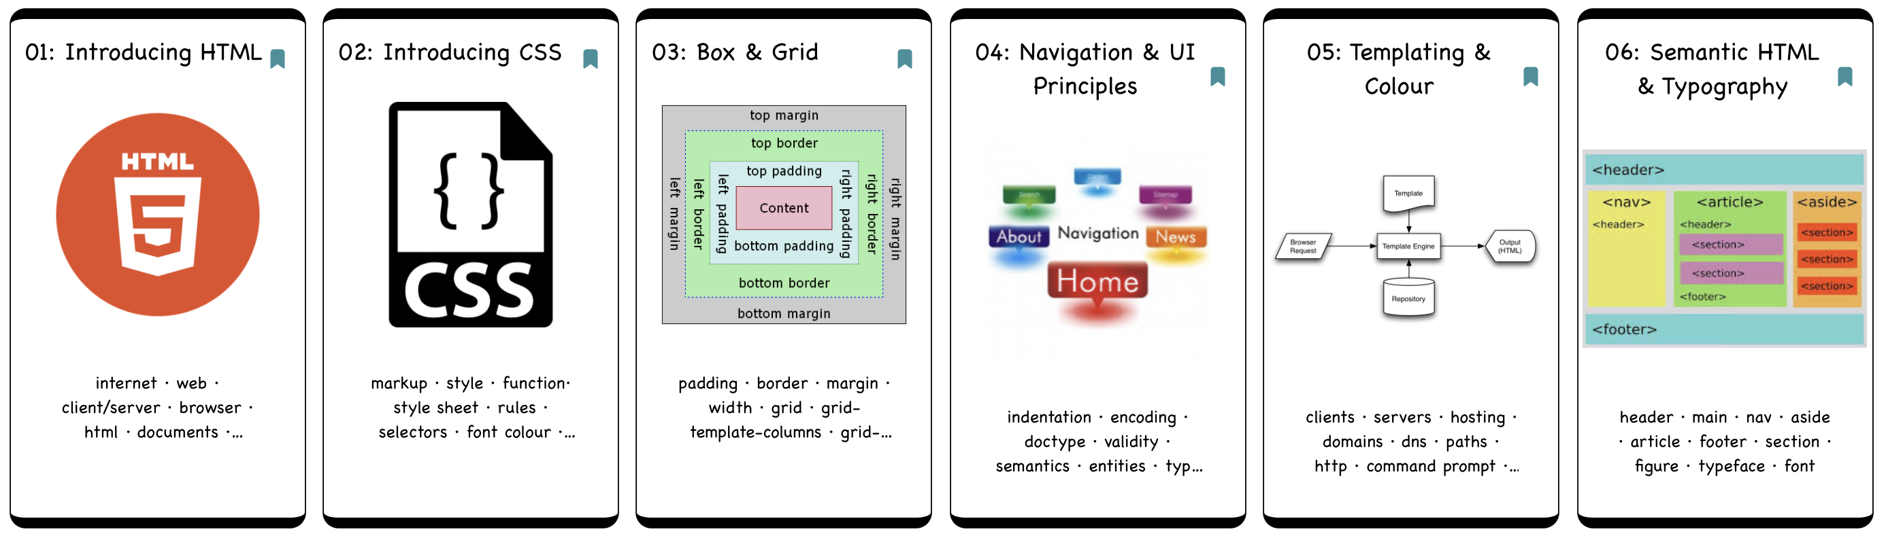
Assignment 1 based on skills acquired in topics 1-6
Allocated 40% of overall module grade

Slide 15
Assignment 2 based on skills acquired in topics 7-12
Allocated 60% of overall module grade

Slide 16
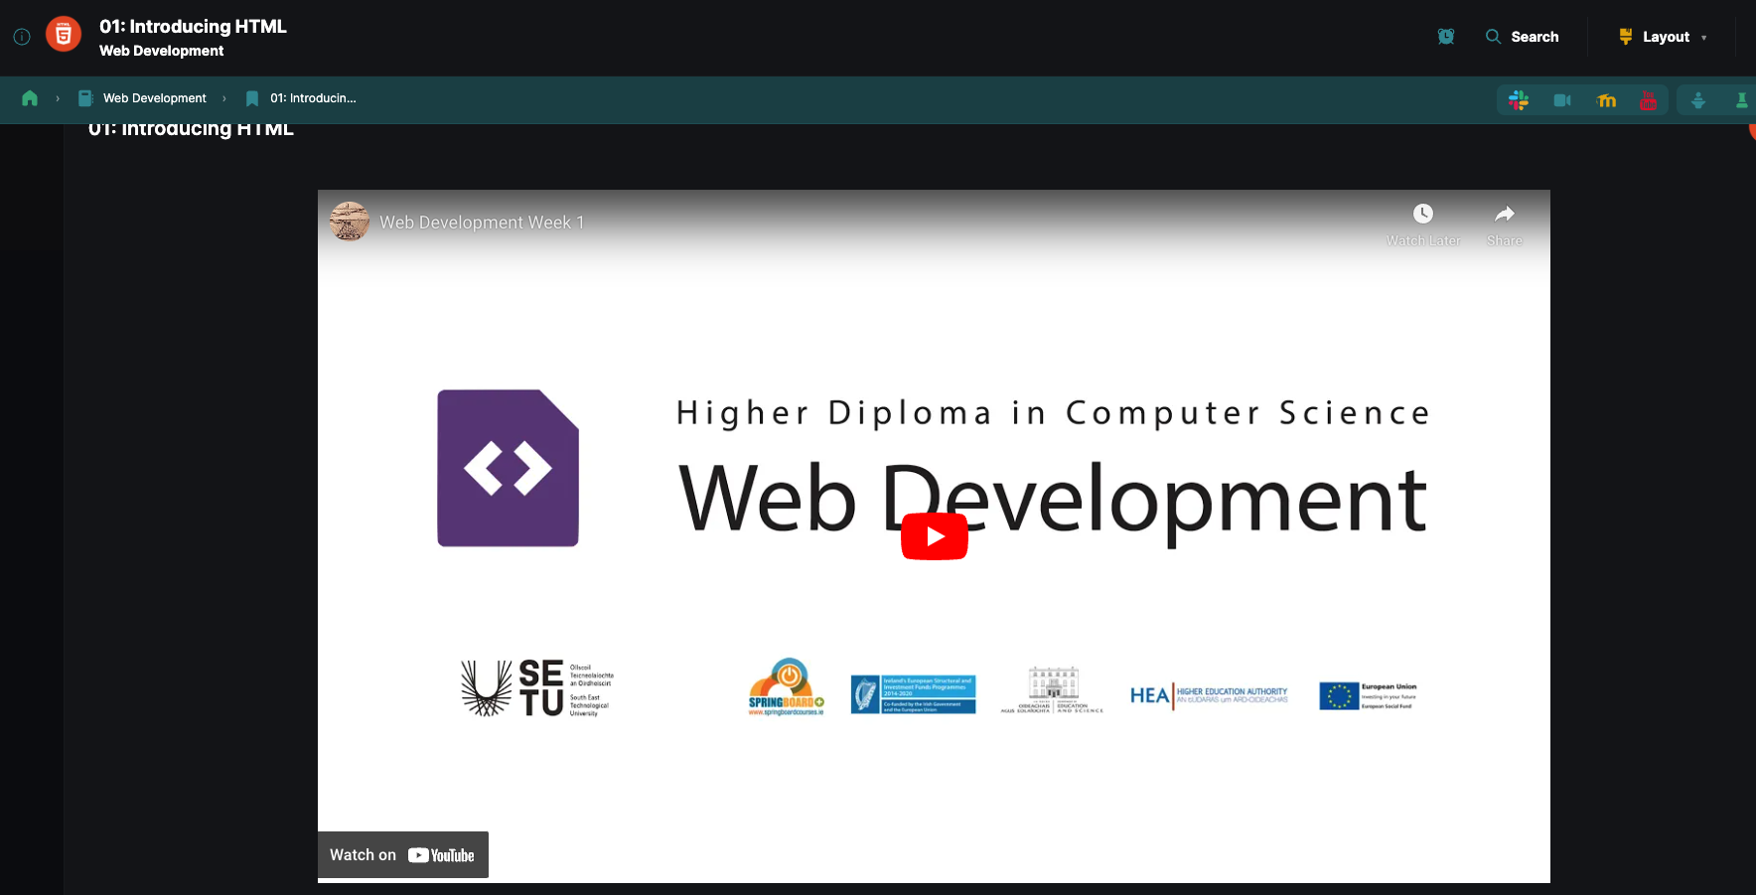
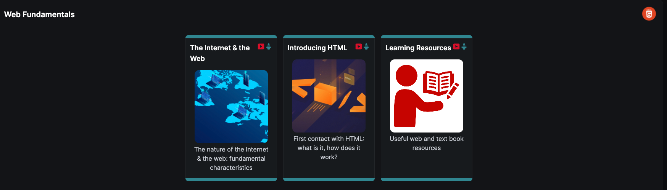
Lectures
Video and PDF Presentations Provided
Some lectures will be “live”, others recorded
All lectures will be recorded
At the end of the live lectures (or at checkpoints), questions from slack can be answered
Live lectures will be followed by an open Zoom call (not recorded) to facilitate questions, feedback and humanity

Slide 17

Lectures
Ah, so I don’t need to take notes!
No Notes ➔

Slide 18
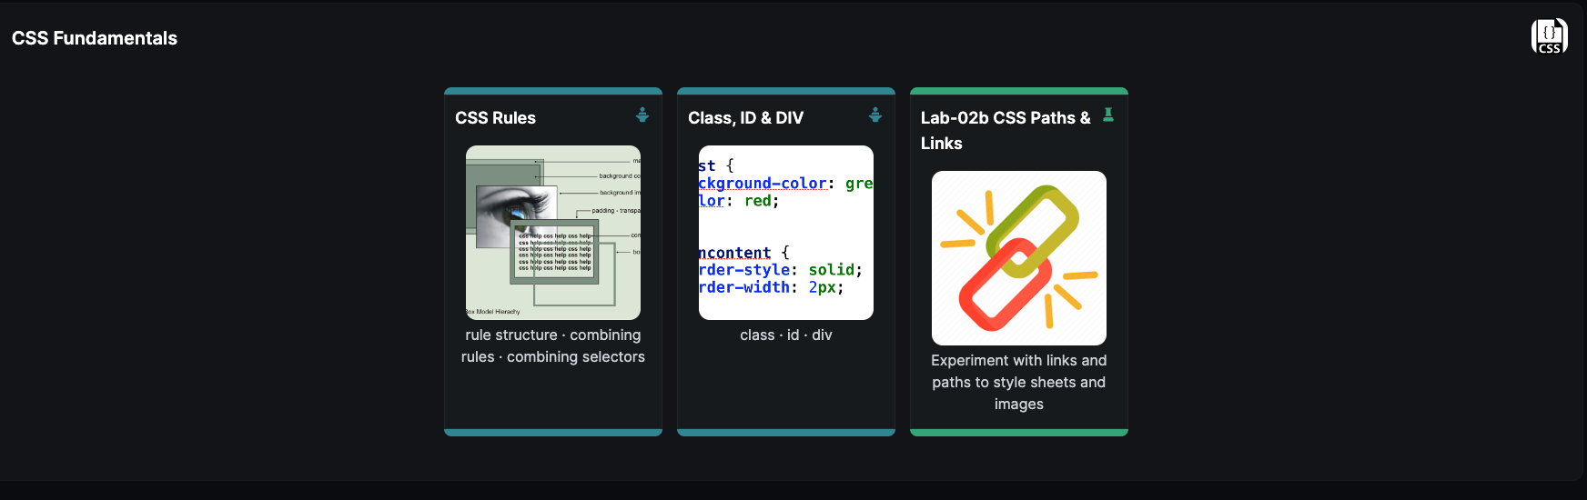
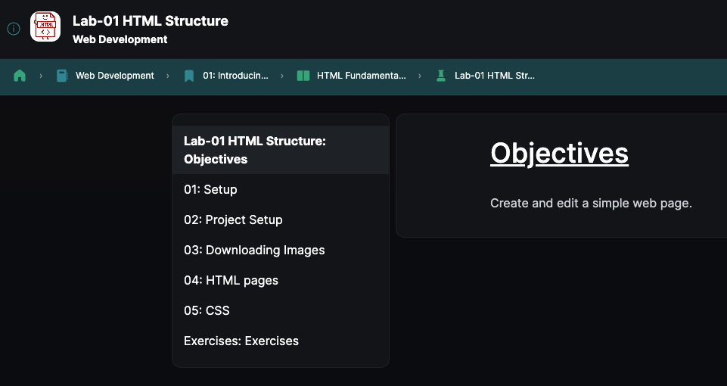
Labs
Step By Step Learn by Doing! (Don’t be tempted to skip)

Slide 19
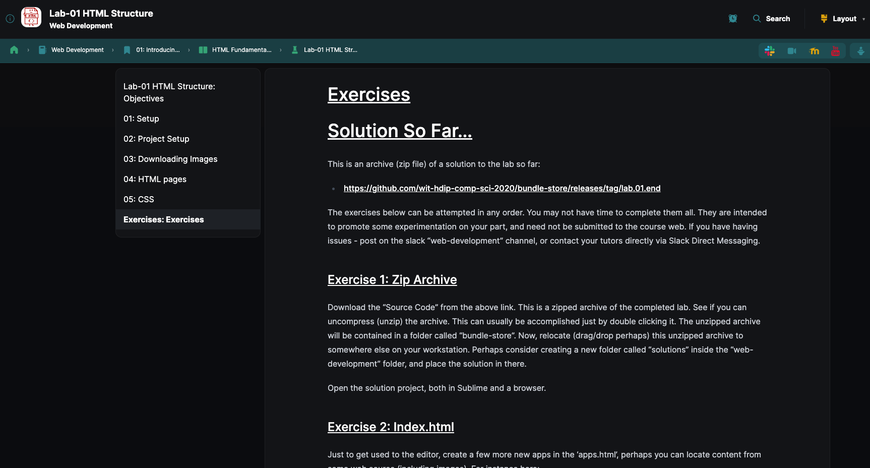
Lab Exercises
Independent Learning
Challenge yourself
It is OK to fail, you need to fail to learn
Exercises are typically in order of difficulty – more difficult as you move down the page

Slide 20

I Need Help!
As a group, you should create a channel to communicate with each other on labs
If all else fails – web dev slack channel - #web-development-1
Lab Exercises

Slide 21
Lab Exercises
Labs are not submitted or graded
However, they are VITALLY IMPORTANT to your learning experience

Slide 22
Recap
Thursday 12:15 – Lectures with Lab Intro at End (Recorded)
Tuesday 19:00 – Zoom Session to help with labs, assignments, whatever (time may change)
Available via Slack to assist throughout the week, we may schedule these times after the dust settles

